Slide 1
Professional Dialogues through World Cafe
September 5, 2017 Chancellor’s Conference Day
*Thank you http://www.theworldcafe.com for the free resources, images, and information which made this session possible.

Slide 2
Activator
Think of a time when you engaged in effective collaboration (personal or professional). (Write it down) (3 minutes)
Turn and Talk: Share your experience with your neighbor. (2 minute)

Slide 3
Session overview & guiding questions
Session Overview:
We will create community around student achievement across roles; redefine the term “collaboration,” identify what it means to support students academically from a SEL perspective.
Guiding Questions:
1. How are we all responsible for student
achievement?
2. How can we collaborate amongst ourselves
and with teachers to support students
academically from a SEL perspective?

Slide 4
Collaboration that supports student achievement
“WORLD CAFÉ”

Slide 5

Welcome to Our World Café!!
Today we will:
Engage in honest, meaningful, success-based, student-centered, professional dialogues
Focus on questions that help us to reflect on collaboration at our sites
Harness our collective wisdom in service of our students

Slide 6
How Does World Café Work?
Your Café Host(s) will pose focus questions
You will engage in a dialogue in response to these question with 3-4 colleagues seated at your table/desk cluster for about 12 minutes
While you converse…

Slide 7


How Does World Café Work?
Participate fully and
professionally

Slide 8


How Does World Café Work?
Engage one another
Every voice is valued in our World Cafe

Slide 9

How Does World Café Work?
Write
Doodle
Draw
Leave your mark

Slide 10

How Does World Café Work?
Keep students at the center of our dialogue

Slide 11

How Does World Café Work?
Gather the collective wisdom of us all in service of our students

Slide 12

How Does World Café Work?
AND…

Slide 13

How Does World Café Work?
A “Table Host” is selected at each table with the responsibility of synthesizing thoughts
After 12 minutes, everyone will move to new tables to begin a new dialogue with a new group of colleagues, the table host remains
Our goal is to hear different perspectives from your colleagues during World Cafe

Slide 14
How Does World Café Work?
Your Café Host(s) will then pose a new focus question and you will have 12 minutes to dialogue
Table Hosts should pull into the conversation key insights from prior dialogues that help build our collective wisdom
After four rounds of dialogue, your Café Host(s) will lead the entire room in a harvesting of collective ideas

Slide 15
How Does World Café Work?
Questions??
Excited??
Ready??
Then let’s begin…

Slide 16
Round one of dialogue
12
minutes
Focus Question:
What is effective collaboration and what does that look like at your site?
Why is it beneficial to collaborate about students with your colleagues at your sites?

Slide 17
Mix and Mingle
2
minutes
Table Hosts stay behind…
and everyone else move to a new table of colleagues

Slide 18
Round two of dialogue
12
minutes
Focus Question:
Where do you talk to your colleagues about students? At lunch? In the halls? Organized meeting?
How you do check in? In person? Via email?

Slide 19
Mix and Mingle
2
minutes
Table Hosts stay behind…
and everyone else move to a new table of colleagues

Slide 20
Round three of dialogue
12
minutes
Focus Question:
Who should be part of the process?
How often should we be meeting with our colleagues?
What are some challenges with collaboration?
How can we overcome some of the obstacles?

Slide 21
Round FOUR of dialogue
12
minutes
Focus Question:
How should collaboration with your colleagues be structured?
What do we intend to accomplish through collaboration?
How can we tell it’s working?

Slide 22
Harvesting Collective Wisdom
20
minutes
As one whole group, let’s share insights from our dialogues which are forward thinking about how we collaborate at our sites.
  Insights & Conclusions?
  New Questions?
  Where do we go from here?

Slide 23
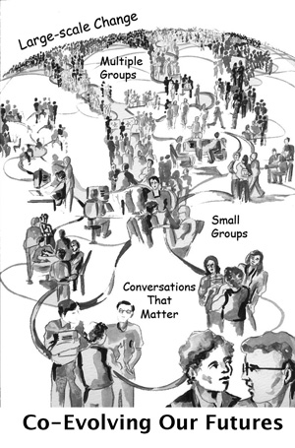
Thank you to http://www.theworldcafe.com for their free resources, images, and information which made this World Café session possible.

Slide 24

Please take this time to fill out an evaluation sheet for World Cafe.
Thank you so much for your time!

