Slide 1

The Instructional Core at P2G: How Are We Teaching Disciplinary Literacy?
Professional Development Chancellor’s Conference Day September 5, 2017
Social Studies Facilitators:
Janet Brown Anderson
Albert Haggerty
Felix Ramos

Slide 2


Activator/ Hook On your post-it notes jot down instructional practices that you currently use to support students in Reading, Writing, and Discussion in Social Studies.
Stick your post-it notes on the corresponding chart paper around the room. (5mins)
As you walk around the room, read some of the practices that your colleagues have posted. (7mins)
Discussion Questions (8 mins)
How do you know what works?
What is the evidence of student learning as a result of using these literacy practices?

Slide 3

Session Goals
To analyze our existing teaching practices.
Explore three research based practices that support reading, writing and discussion in social studies.
To determine how to apply the instructional practices within the social studies classroom to effectively strengthen all of our students’ disciplinary literacies.

Slide 4
Guiding Questions
What instructional practices are we currently employing that supports student reading, writing and discussion within social studies? (Current Reality)
How do we know what works? What is the evidence of student learning? (Previous Data)
How can we employ research- based instructional practices for disciplinary literacy to meet the needs of all our learners at P2G- at all academic levels, including English language learners and students with disabilities? (Building Our Instructional Core)

Slide 5
What?
3 Research Based Practices
Annotation for Reading
Annotation for Writing
Structured Discussion: Accountable Talk
So What?
As the social studies content team we will evaluate how these practices support our Instructional Core. Our goal over the course of the year is to determine which practices should be part of our Instructional Core based on evidence of their impact on student learning.
Now What?
Routinize the ongoing application of these practices in your classroom during September and October so that we can evaluate how these instructional practices impact student learning.

Slide 6
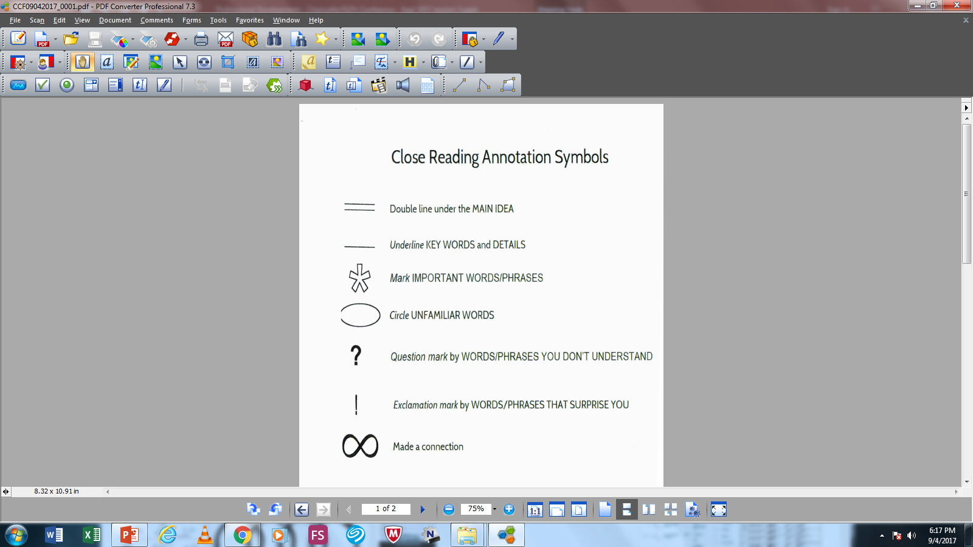
RBP#1: Annotating for Reading Comprehension
Rationale
In annotating a text, students become active readers, asking and answering questions, making connections both to prior knowledge and other texts, and summarizing-all widely endorsed reading comprehension strategies.
Annotation involves highlighting, underlining and making marginal notes while reading a document.
Annotation allows the student to better comprehend the document that is being read.
Breaking a document into components is a more concrete and manageable approach than trying to respond to an entire document initially.
Modeling activity (show then apply)

Slide 7
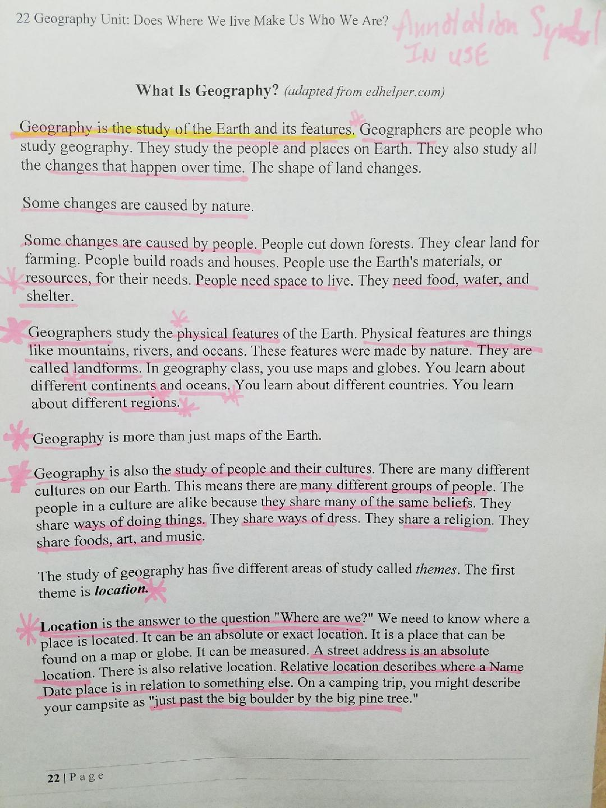

Slide 8

RBP#2: Annotation and Mini-Writes
What is it?
Pre writing strategies that help students understand content, think historically and prepare for culminating assignments.
Rationale
Writing allows students to go beyond just summarizing.
Integrating writing throughout the curricular unit allows students to grasp the content, learn to think historically and practice.
Informal writing exercises allow students to think through historical documents on their own.
Assign mini writes/writing prompts at beginning of class or as homework.

Slide 9
Mini – Write Activity
After reading and annotating the article answer the following question:
Why is the area around the basin of the Pacific Ocean known as the Ring of Fire?
“The Ring of Fire is an area in the Pacific Ocean where a large number of volcanic eruptions and earthquakes take place. The Ring of Fire is unique because the plate boundaries on which it lies are part of highly populated areas, like the West coast of the U.S., the Philippines and Japan.”
Source: The Variety of Maps

Slide 10
Group Practice- Let’s Write!
Using the annotations you have made, provide evidence to support the author’s claim below:
“People use maps to understand much more than distance and location: they are not just keeping us from getting lost!”

Slide 11

RBP#3: Structured Discussion – Accountable Talk
What is it?
Structured discussion involves designing opportunities into your lesson for students to engage in deeper meaningful conversations that utilize the content vocabulary with one another.
Rationale
Provides students with an opportunity to articulate their understanding, explain their arguments, and listen to how others think.
Participation in controversial discussion allows students develop their support for democratic values and it creates an “open classroom climate.”
Students tend to enjoy course that emphasize discussion since it “enhanced what they learned and made learning more engaging and fun”

Slide 12
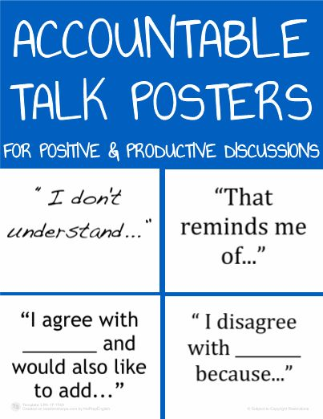
Accountable Talk
What is the difference between a plate tectonic map and an elevation map? (2mins)
How would you respond to people that argue that Google maps is the only map you will ever need? (3mins)
Knowing what we know about the Earths Geography, why do people still live in dangerous places? (3mins)

Slide 13
Debriefing and Evaluation: Reflect on the three disciplinary literacy practices that were just modeled.
Questions to consider:
What do you notice yourself or others doing (as students) while using these three practices?
How did the facilitators (as teachers) support you in using these three practices?
How could these three practices support reading, writing, and discussion in your content area among: English language learners, Students with disabilities, Literacy level students, Satellite level students (pre-HSE/HSE)

Slide 14
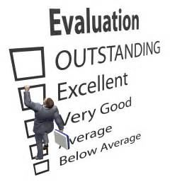
PL Evaluations
Please take the time to honestly complete the evaluations. (5mins)
Notes:
Ask a volunteer from the participants to collect all evaluation sheets and seal them in the manila envelope to give back to us.

