Slide 1

Career Planning
Roads to Success

Slide 2
Celebrity Early Jobs
Where you start is not where you are going to end up; starting at the bottom of the ladder is normal for everyone.

Slide 3
The Road: Entry-Level Employment
Start at the bottom of the ladder (such as a janitor, office assistant, sales clerk, or mailroom clerk) and climb your way up through promotion to eventually earn the position you really want.

Slide 4
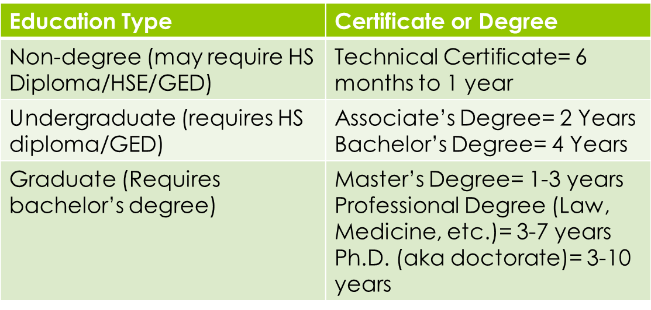
The Road: College
Attend a community college, four-year college, or university to earn one or more certificates or degrees in a specific area.

Slide 5
The Road: Apprenticeship
Apprenticeship means learning a skilled trade (like plumbing, construction, and electrical work) through paid on-the-job training under the guidance of experienced craftsmen, plus related classroom training.

Slide 6
The Road: Internship/Volunteer
An internship is on-the-job training for white-collar and professional careers, similar to apprenticeships for trade and vocational jobs. Interns agree to work for minimal or no pay for a set period of time in order to gain experience, contacts in a particular field, and occasionally school credit. Some companies will hire exceptional interns directly upon completion of the internship, but this is not guaranteed.

