Slide 1

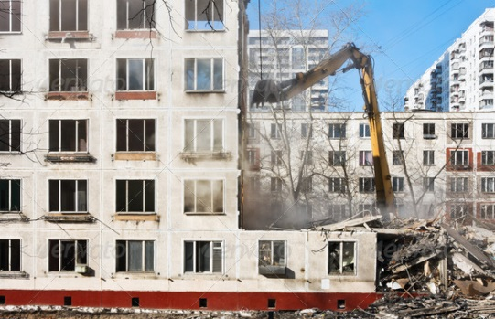
The Government
Your Apartment
“I want your
apartment building!”

Slide 2
Definitions
Eminent - standing above others in some quality or position
Domain - complete and absolute ownership of land

Slide 3
Eminent Domain
The right of a government to appropriate privately owned land or property for public use upon payment of compensation to the owner.
The Fifth Amendment to the Constitution of the United states says, “ private property shall not be taken for public use without just compensation.”

Slide 4
A government, (federal, state, or local) or government agencies have the power to take private property for public use by compensating the owner. Examples of some agencies would be airport authorities, the Port Authority of NY/NJ, highway commission, and utility companies

Slide 5
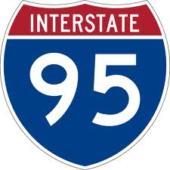
The Dwight D. Eisenhower National System of Interstate and Defense Highways (commonly known as the Interstate Highway System, Interstate Freeway System, Interstate System, or simply the Interstate) is a network of freeways that forms a part of the National Highway System of the United States. The system is named for President Dwight D. Eisenhower, who championed its formation. Construction was authorized by the Federal Aid Highway Act of 1956.

Slide 6
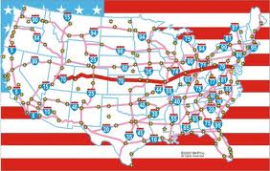

Slide 7
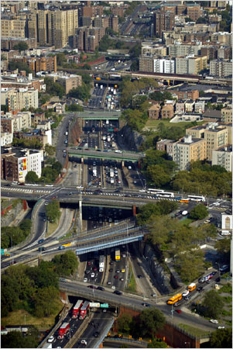
The Cross Bronx Expressway

Slide 8
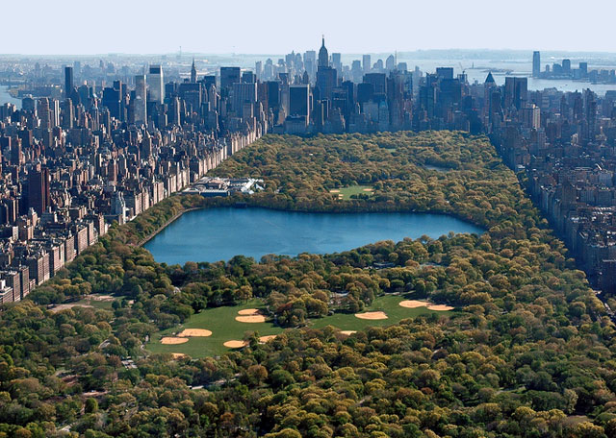
Central Park

Slide 9
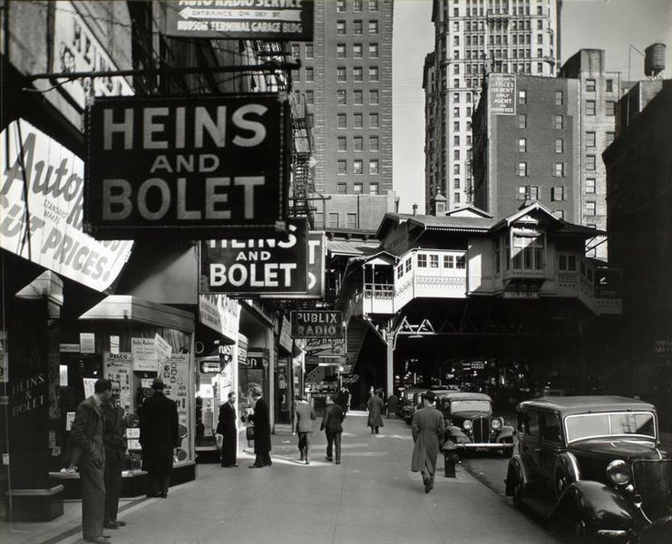
The World Trade Center
The World Trade Center site, Cortlandt Street in 1936.

Slide 10
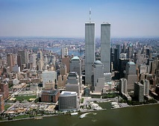
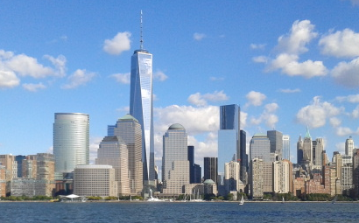
The World Trade Center
2000
2013

Slide 11
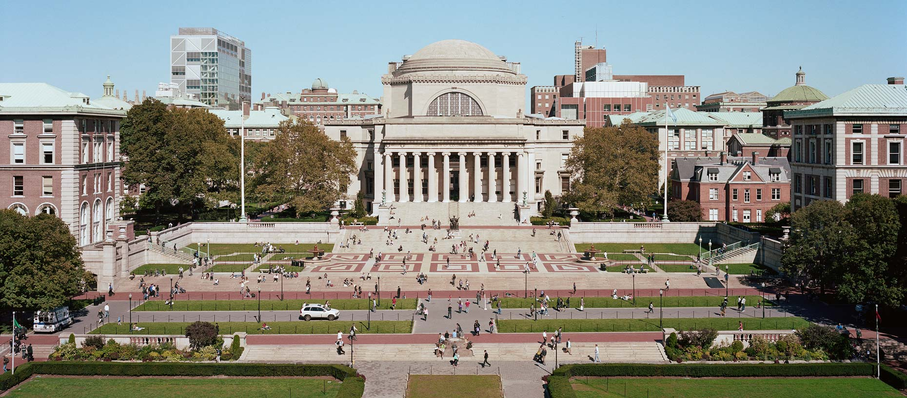
Columbia University

Slide 12
The Battle!
The Government takes citizen's property for the benefit of the public.
vs
A private, for profit, company asking the government to take citizen's property for questionable public benefit and private benefit.

