Slide 1

Financial Aid 101:
Parent Workshop

Slide 2
Topics We Will Discuss
What is Financial Aid?
Types and Sources of Financial Aid
What is Financial Need
Cost of Attendance
The Expected Family Contribution (EFC)
Free Application for Federal Student Aid (FAFSA)
Special Circumstances
Documents Needed to Complete FAFSA

Slide 3
KWL Chart
Purple Post-it – “K”
What do you already know about Financial Aid? (Ex: “Financial aid is money to pay for college.”)
Blue Post-it – “W”
What do you want to know about Financial Aid? (Ex: “Do we have to pay the money back after our student graduates?”)

Slide 4
What is Financial Aid?
Financial aid is funds provided to students and families to help pay for post-secondary educational expenses
Trade/vocational schools
2-year schools
4-year schools
Graduate programs

Slide 5
Types of Financial Aid
Grants
Loans
Scholarships
Employment

Slide 6
Grants
Money that does not have to be paid back
Usually awarded on the basis of financial need
Pell Grant is the most common
$5,550 maximum amount awarded a year

Slide 7
Loans
Money students and parents borrow to help pay educational expenses
Repayment usually begins after education is finished
Only borrow what is really needed
Look at loans as an investment in the future
Government loans vs. private loans

Slide 8
Scholarships
Money that does not have to be paid back
Awarded on the basis of merit, skill, or a unique characteristic

Slide 9
Employment
Allows student to earn money to help pay educational costs
A paycheck
Non-monetary compensation, such as room and board
Work-Study is the most common

Slide 10
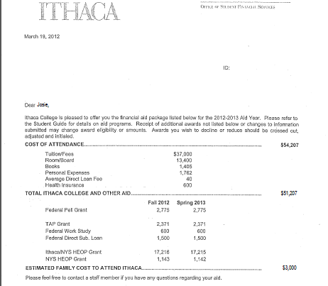
Sample Financial Aid Award Letter
Cost of Attendance
Grants

Slide 11
Categories of Financial Aid
Need-based
Income + household size + school credits
FAFSA
State Aid (TAP for NYS)
Non need-based
Scholarships
Loans

Slide 12
What is Financial Need?
Calculation:
Cost of Attendance
– Expected Family Contribution
= Financial Need

Slide 13
What is Cost of Attendance (COA)?
Direct and indirect costs combined into cost of attendance
Vary widely from college to college

Slide 14
What is Cost of Attendance (COA)?
Direct costs
Tuition
Books
Campus Housing

Slide 15
What is Cost of Attendance (COA)?
Indirect costs
Off-campus Housing
Travel Expenses
Childcare (if applicable)
Food

Slide 16
What is the Expected Family Contribution (EFC)?
Formula used to determine award eligibility
Stays the same regardless of college
Two components
Parent and student information
Calculated using FAFSA data and a federal formula

Slide 17
What is Financial Need?
Calculation:
Cost of Attendance
– Expected Family Contribution
= Financial Need

Slide 18
What are the primary sources of this funding?

Slide 19
Sources of Financial Aid
Federal Government - FAFSA
States – TAP
Private sources
Civic organizations and churches
Employers

Slide 20
Federal Government
Largest source of financial aid
Pell Grant is the most common
Aid awarded primarily on the basis of financial need
Must apply every year using the FAFSA
Free Application for Federal Student Aid

Slide 21
Common Federal Aid Programs
Grants
Federal Pell Grant
Federal Work-Study
Federal Supplemental Educational Opportunity Grant
Loans
Federal Perkins Loan
Stafford Loans
PLUS Loans

Slide 22
State Aid
For New York State: Tuition Assistance Program (TAP)
Residency requirements
Award aid on the basis of both merit and need
Use information from the FAFSA
Deadlines vary by state
Separate application

Slide 23
Private Sources
Foundations, businesses, charitable organizations
Deadlines and application procedures vary widely
Begin researching private aid sources early

Slide 24
Civic Organizations and Churches
Research what is available in community
To what organizations and churches does student and family belong?
Application process usually spring of senior year
Small scholarships add up!

Slide 25
Employers
Companies may have scholarships available to the children of employees
Companies may have educational benefits for their employees

Slide 26
How and when should you apply for financial aid?

Slide 27
Documents Needed
Social Security Card
Parent and Student 2012 Federal Income Tax Return
Student if applicable
Student: Annual income more than $7,000
IRS Form
Parents/Guardians marriage and/or divorce dates
Foreign Tax Return
Alien registration or permanent resident card

Slide 28

FAFSA on the Web
Web site: www.fafsa.ed.gov
Electronic best
2013-2014 FAFSA on the Web available on January 1, 2013
FAFSA on the Web Worksheet:
Used as “pre-application” worksheet
Questions follow order of FAFSA on the Web

Slide 29
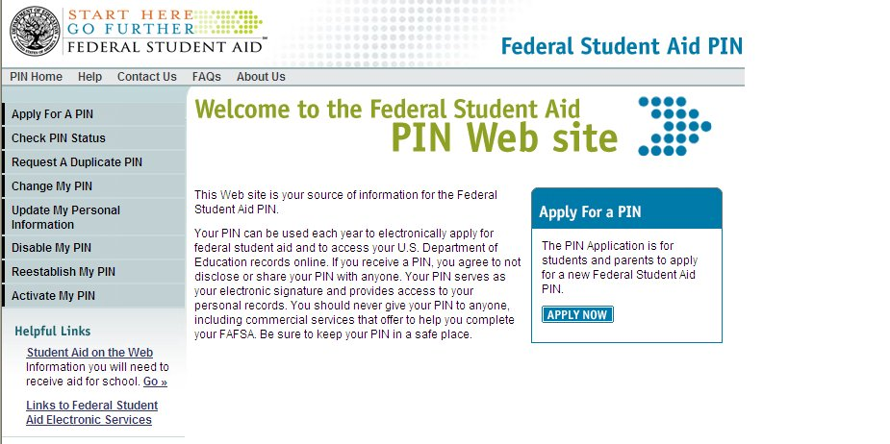
Student/Parent Financial Aid PIN
Web site: www.pin.ed.gov
Sign FAFSA electronically
4 digits
Not required, but speeds processing
May be used by students and parents throughout aid process, including subsequent school years
Keep in a SAFE place

Slide 30
Signatures
Required
Student
One parent (dependent students)
Format
Electronically using PIN
Signature page
Paper FAFSA

Slide 31
Frequent FAFSA Errors
Social Security Numbers
Divorced/remarried parental information
Income earned by parents or step-parents
Untaxed income
U.S. income taxes paid
Household size
Number of household members in college
Real estate and investment net worth

Slide 32
Tuition Assistance Program: TAP
Tuition Assistance Program
NYS Aid
Completed after FAFSA Application
Information from FAFSA application is pre-populated

Slide 33
Special Circumstances
Cannot report on FAFSA or TAP
Send explanation to financial aid office at each college
College will review special circumstances
Request additional documentation
Decisions are final and cannot be appealed to U.S. Department of Education

Slide 34
Special Circumstances
Change in employment status
Medical expenses not covered by insurance
Change in parent marital status
Unusual dependent care expenses

Slide 35
Tax Season is Financial Aid Season
February – File your Taxes
February/March – Complete Financial Aid Applications
Complete college application prior to completing Financial Aid
Financial Aid funds are first come first serve!

Slide 36
Activity: Financial Aid Comparison Sheet
You will need
Complete Financial Aid comparison sheet
1 blank sheet comparison sheet
1 Sample Financial Award Letter
Apply what you know

Slide 37
Wrap-Up
KWL Chart
Complete “Learn” section
Q&A

