Slide 1
Supporting Immigrant Students
in the College Process
Sarah Cacicio
Program Coordinator for Immigrant Services

Slide 2
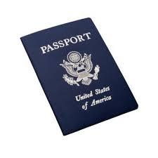
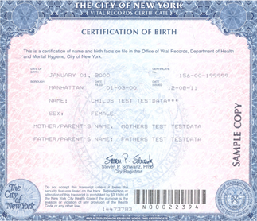
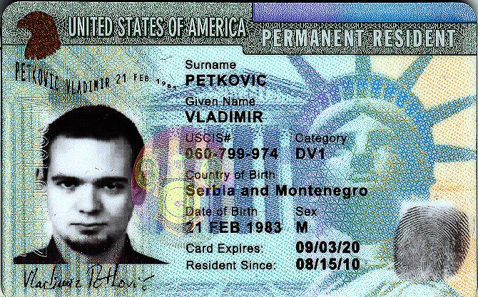
Classifying Immigration Statuses
U.S. Citizen
Lawful Permanent Resident (Green Card Holder)

Slide 3
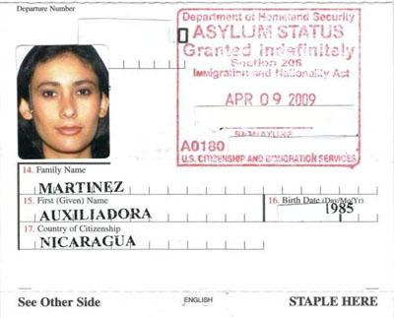
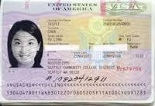
Classifying Immigration Statuses
Refugee and Political Asylee
Non-Immigrant Visa Holder

Slide 4
Classifying Immigration Statuses
Undocumented or Unauthorized
Entered Without Inspection (border)
Overstayed Visa (tourist or student)
Violation of Status
False Documents (using relative’s ID)
Trafficked

Slide 5
Immigration Relief
SIJS: Special Juvenile Status
DACA: Deferred Action for Childhood Arrivals
DAPA: Deferred Action for Parent Accountability

Slide 6
Special Juvenile Status
SIJS is a form of self-petition. It can lead to citizenship for youth who are:
Under 21 years old and unmarried
In foster care, guardianship, or adopted
Have a finding of abuse or abandonment
Cannot return to home country
Have no criminal convictions

Slide 7
What is DACA?
Protection from deportation for up to 3 yrs
Note: This is not a pathway to citizenship or permanent residency. Must be renewed.
Access to legal work authorization
Access to Social Security Card and state ID
Financial Benefits in college
You may be eligible for certain scholarships, financial aid, and in-state tuition.

Slide 8
Qualifications: DACA
DACA Deferred Action for Childhood Arrivals
Individuals who meet the following criteria can apply for DACA
are under 31 years of age as of June 15, 2012
came to the U.S. while under the age of 16
have continuously resided in the U.S. from June 15, 2007 to the present.
entered the U.S. without inspection or fell out of lawful visa status before June 15, 2012
were physically present in the United States on June 15, 2012, and at the time of making the request for consideration of deferred action with USCIS
are currently in school, have graduated from high school, have obtained HSE, or have been honorably discharged from the Coast Guard or armed forces;
have not been convicted of a felony offense, a significant misdemeanor, or more than three misdemeanors of any kind
do not pose a threat to national security or public safety.

Slide 9
Financial Aid
Undocumented students are NOT eligible for federal financial aid.
They should NOT file the FAFSA.
U.S. Citizens with Undocumented Parents should file the FAFSA.
Undocumented Parents 000-000-000 as Social Security number
Do not apply for pin. Mail in signature page.

Slide 10
Scholarships for Undocumented Students
CUNY The Dream.US
http://www1.cuny.edu/sites/6/admissions/financial-aid/scholarships/the-dream-us/
TheDream.US
http://www.thedream.us/
NYS Youth Leadership Council
http://www.nysylc.org/scholarships-2/
Options Institute
http://www.goddard.org/uploads/options_training/1413828799_Options%20Institute%20flyer%20Spring%202015.pdf
Bronx Community College
http://www.bcc.cuny.edu/scholarships/documents/PDF%20Scholarship%20International-REVaug.pdf
LaGuardia Community College
http://www.lagcc.cuny.edu/uploadedFiles/Main_Site/Content/Financial_Aid/Main_Menu/Scholarships/Scholarships.pdf
NYU Financial Assistance for Undocumented
http://www.nyu.edu/admissions/financial-aid-and-scholarships/undocumented.html

Slide 11
NYIC Key to the City Events
FREE Legal, MX Consular and Social Services for P2G Immigrant Youth!
January - Brooklyn
February - Brooklyn
March - Manhattan
April - Staten Island
FYI: New York Immigration Coalition: http://www.thenyic.org/node/3612

Slide 12
If you have any questions...
Sarah Cacicio
Coordinator for Immigrant Services
Pathways to Graduation, NYC DOE
Office: 718-935-4971
Mobile: 646-256-3417
Email: SCacicio@schools.nyc.gov

