Slide 1
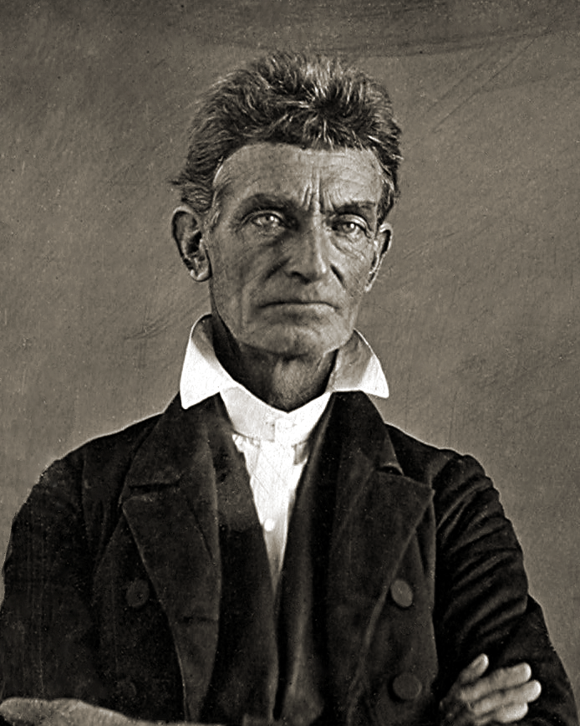

Slide 2
“What do you know about Brown’s early life that might’ve influenced his actions and beliefs?”

Slide 3
American writer, Henry David Thoreau said of Brown, “No man in America has ever stood up so persistently and effectively for the dignity of human nature.”
Did John Brown truly respect the dignity of human nature?

Slide 4
“Is it not possible that an individual may be right and a government wrong?”
Consider this statement in light of Brown’s actions.

Slide 5
American president Abraham Lincoln described Brown as a misguided fanatic. What is your opinion of this statement?
What evidence do you have to support your opinion? Perhaps another way to approach this question is to think, was John Brown sane or insane?

Slide 6
It has been said that John Brown did a bad thing to bad people for good reasons.
What is your opinion of this statement? What evidence do you have to support your claim?

