Slide 1

Khan Academy Tutorial
Adapting Khan Academy for the P2G classroom

Slide 2


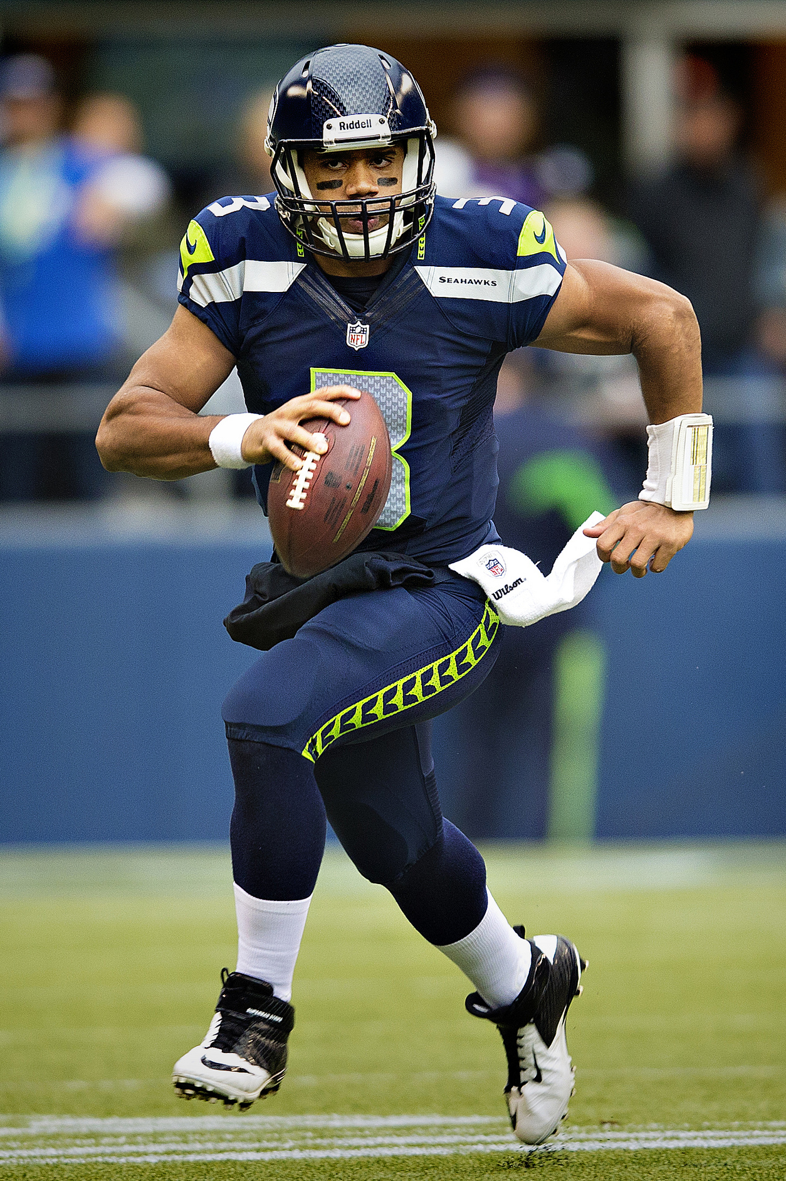
If you could add one more person to your classroom who would it be?
Steve Jobs – Co-Founder of Apple
Doug Lemov – Author of Teach Like A Champion
Russell Wilson – Quarterback of the Seattle Seahawks

Slide 3
What is Khan Academy?
Khan Academy is a non-profit educational website created in 2006 by educator Salman Khan, a graduate of MIT and Harvard Business School. The stated mission is to provide 'a free world-class education for anyone anywhere'.
-Wikipedia

Slide 4
Resources
Over 4000 short lectures
1 min to 4 min
Variety of subjects including math, science, economics & finance, humanities, and computer programming
Over 100,000 exercise problems
Basic Skills – Advanced Calculus practice problems
Common Core aligned objectives and questions
Individualized to each student’s prerequisite knowledge

Slide 5
Khan Academy is: Accessible
Seamless Integration On:
Desktop/Laptop Computer
Tablet
Smartphone
Connect With:
Google Account (Gmail Password)
Facebook
Any Email Address
Teacher Created Accounts

Slide 6
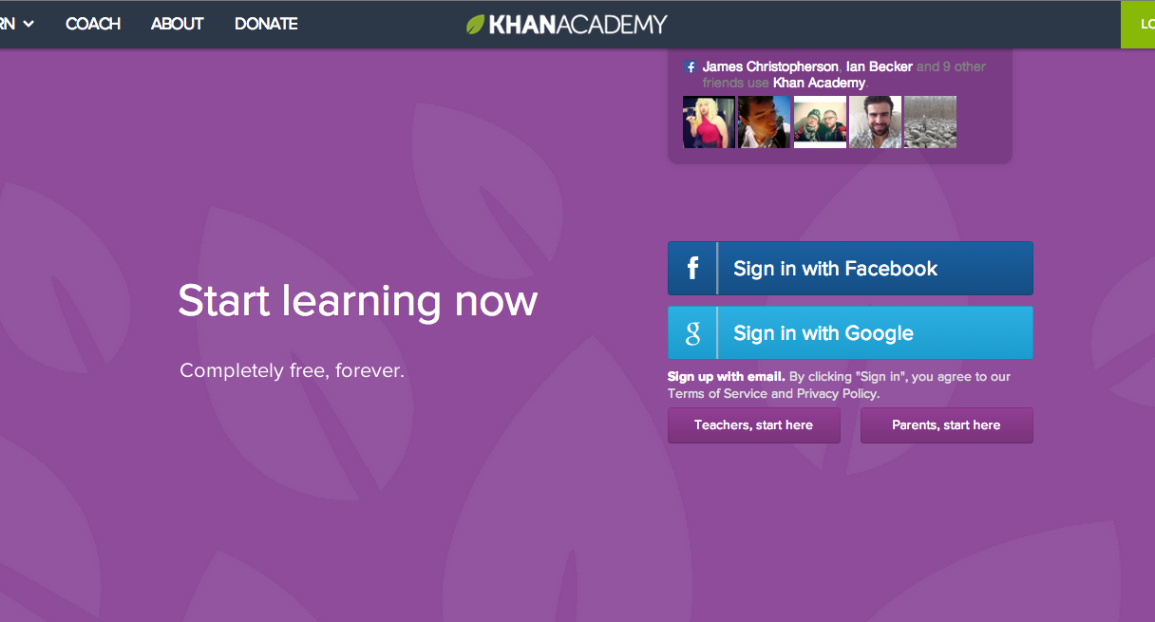
Easily Log on

Slide 7
Khan Academy is: Data Rich
Access a Wealth of Information on Students:
Concept Mastery
Time Logged (In & Out of School)
Content Focus
Who’s Struggling
Recent Activity

Slide 8
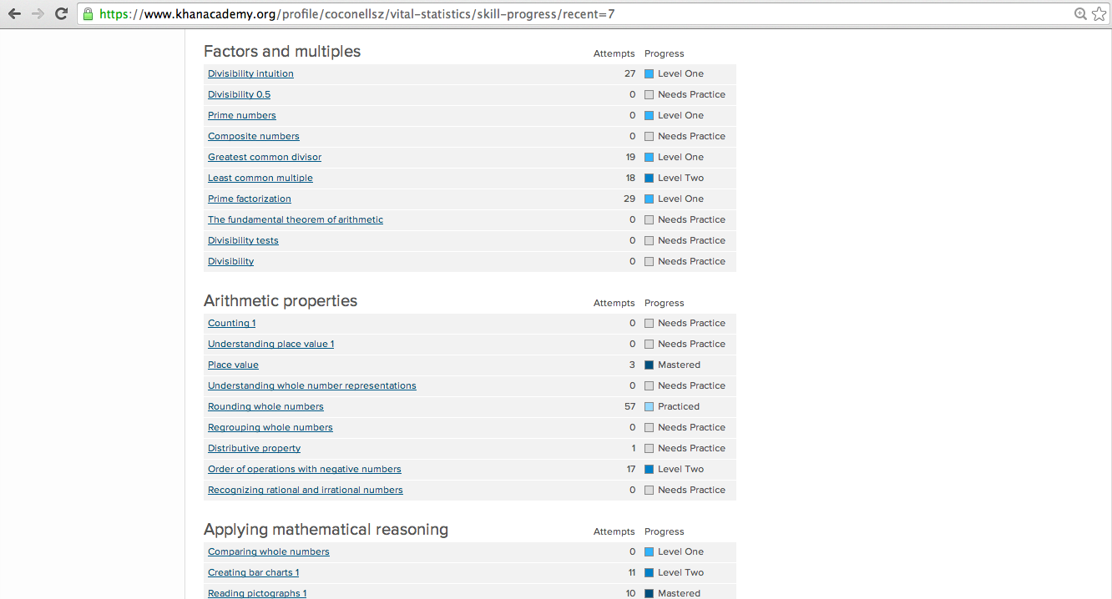
Concept Mastery
Easily determine what skills a student is proficient on

Slide 9
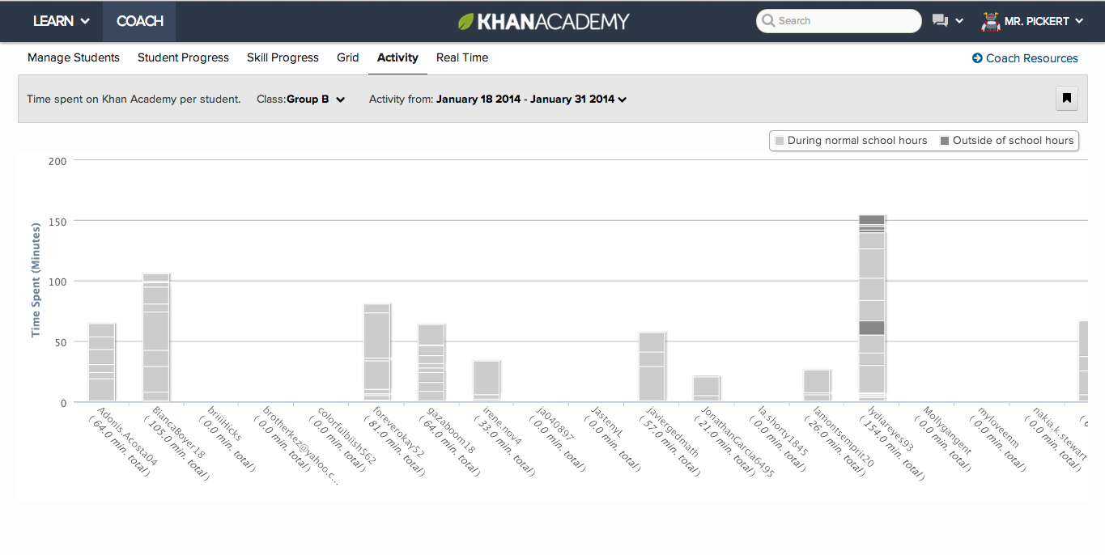
Time Logged
Hold students accountable for work in school and out

Slide 10
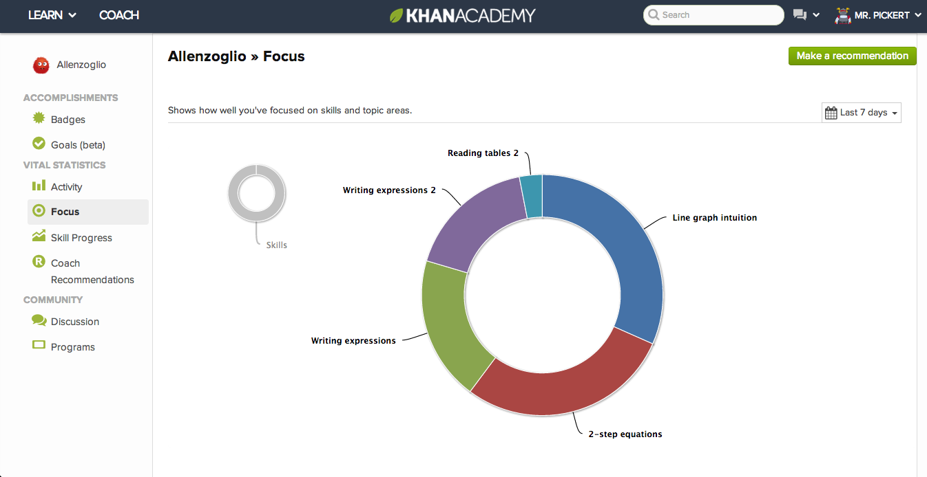
Focus
See what students have focused on for the week

Slide 11
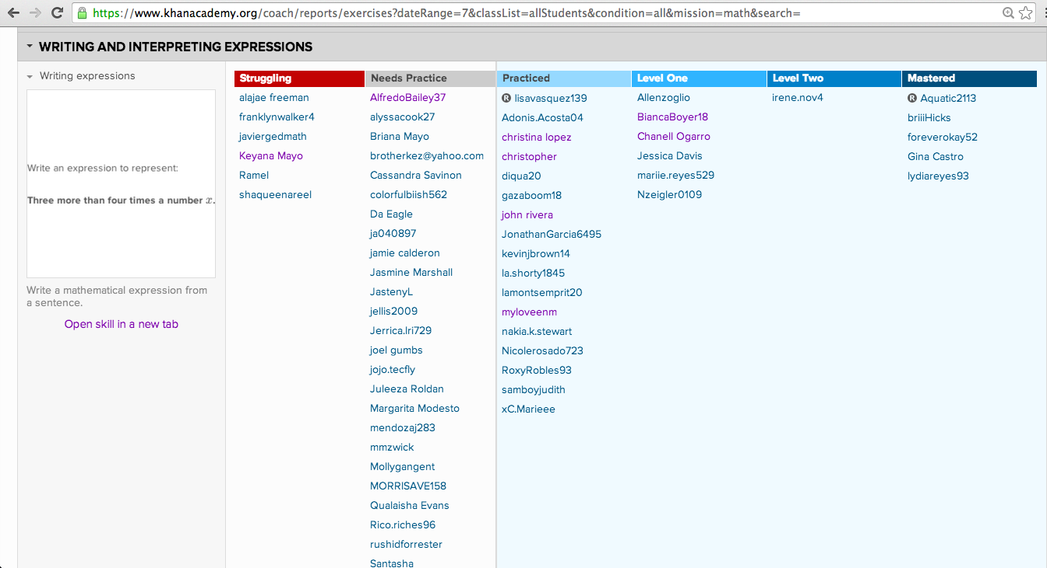
See Who’s Struggling
Easily determine who needs extra help on an objective

Slide 12
Khan Academy is: Fun
Create a Joyful Culture of Achievement With:
Avatars based on achievement
Friendly competition between classmates
Scaffolded challenges tailored to concepts students are practicing.
A unique pathway to mastery for each learner

Slide 13
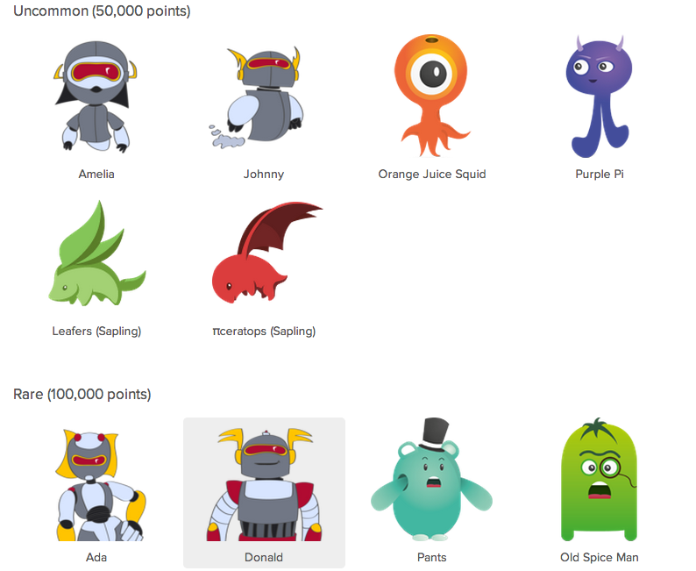
Avatars
Students unlock new profile pictures with “energy points”

Slide 14
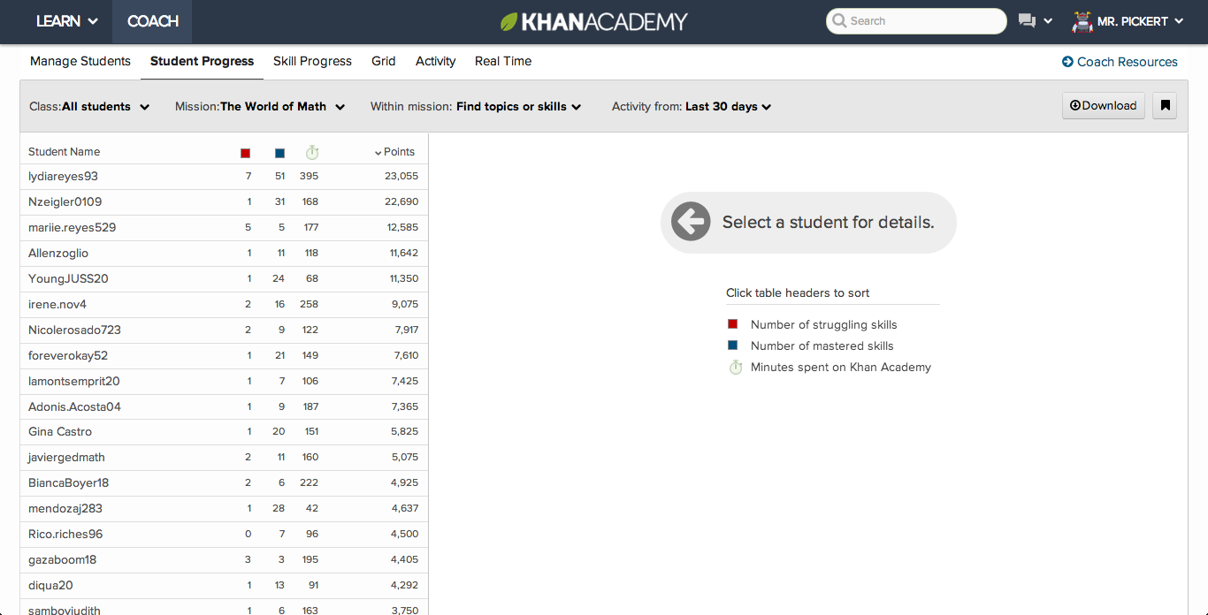
Competition Based on AChievement
Students are ranked on achievement not intelligence

Slide 15
Khan Academy CAN: Differentiate
Differentiate Enrichment/Independent Practice
Students are always on level based on mastery of prerequisite concepts
Students can learn at their own pace with hints, videos, and help boards
Students who need harder work will certainly find it!

Slide 16
Khan Academy CAN: Assess Skill Gaps Quickly
Painless Diagnostic
First time users take a short 8 question quiz
Questions are dynamically generated based on student responses
Achievement Visualizations
Quickly see what you have learned on a “Knowledge Map”
“Learning Dashboard” displays achievement in line graphs, pictographs, bar charts, and avatars.

Slide 17
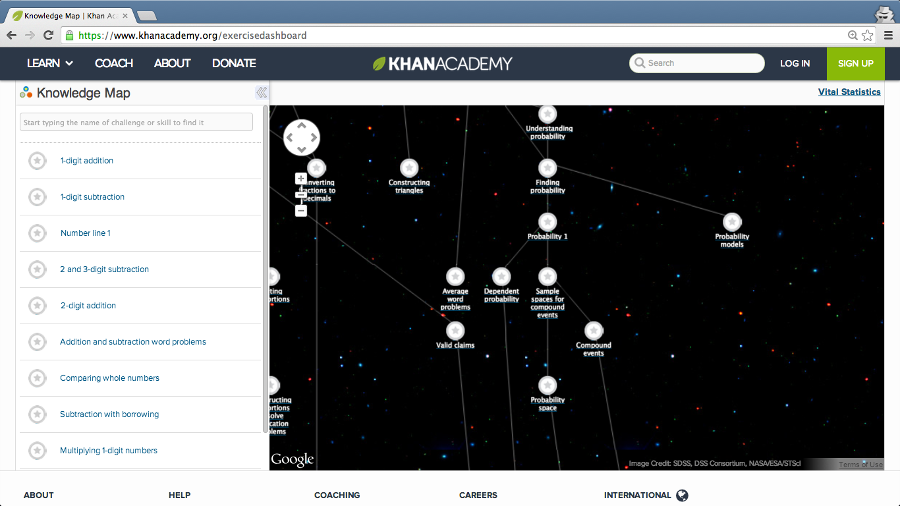
Knowledge Tree
Shows math skills and their prerequisite skills

Slide 18
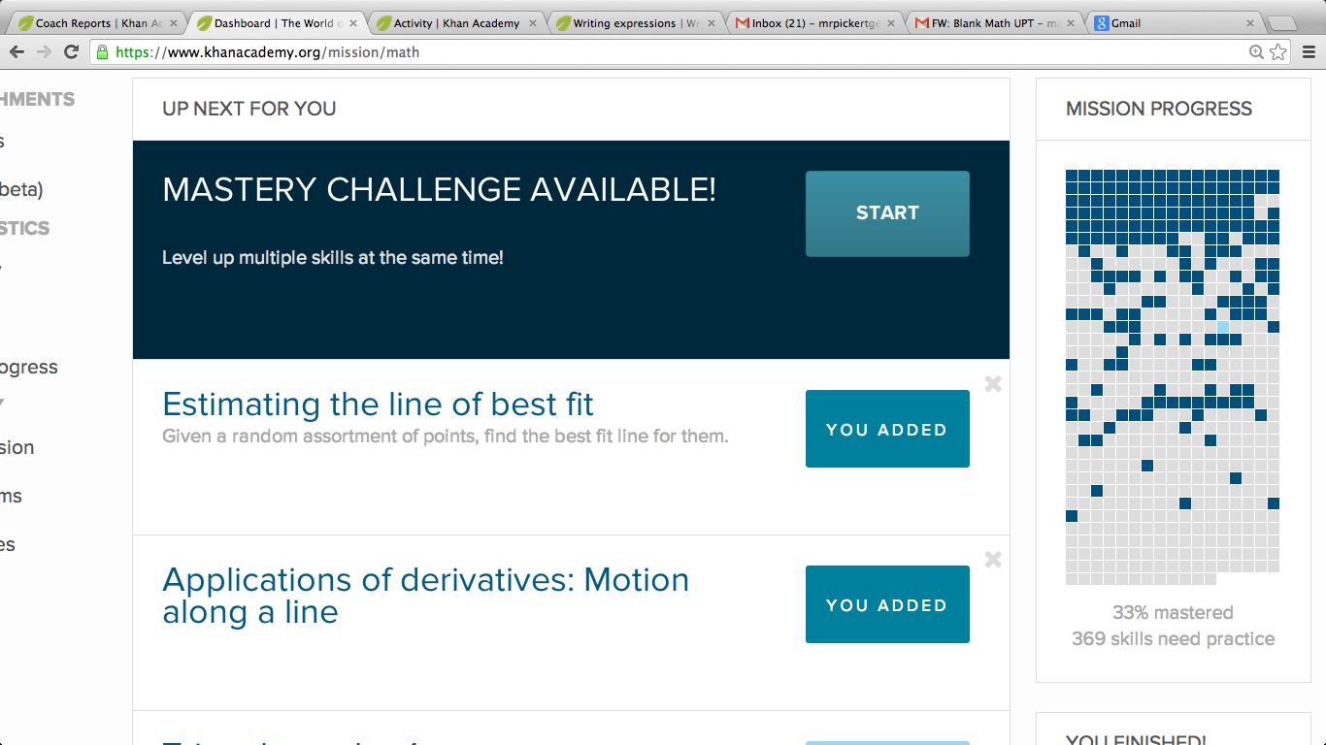
Your Achievement Visualized
Easily see how close you are to mastering the world of math

Slide 19
Khan Academy CAN: Equip Teachers with data
Use data to inform instruction
Group students based on skill mastery
Easily conference with students
Discuss time spent, activities completed etc
Show clear correlation between time spent studying and achievement

Slide 20
P2G Case Study & Demo: #1
The new TASC test has be unveiled and you realize that you as a teacher do not have a good grasp of how to teach ____________.

Slide 21
P2G Case Study & Demo: #2
In planning a week long unit, your performance task is the following DOK 4 question:
You would like to have students practice answering questions of this difficulty but do not know which prerequisite skills students may be missing.

Slide 22
P2G Case Study & Demo: #3
A student enters class on Wednesday having missed Monday and Tuesday’s lesson on writing expressions. Today the class is working on writing equations for complex real-life scenarios.

Slide 23
Breakout Activity
At your table log on to KhanAcademy.org and locate:
One piece of educational content that you could use in your math unit plan.
One feature or data menu that could better inform your instruction.

Slide 24
Share-out

